Slide 1
Mrs Wraith’s weekly writing challenges
Hello Banks Lane!
Each week I will set 3 new writing challenges for you to have a go at in your learning logs. Have fun and send us your amazing ideas.

Slide 2
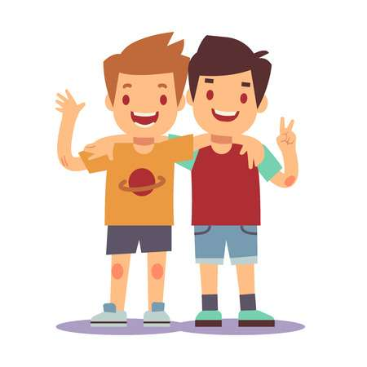
1. Friend swap
It’s difficult at the moment as we can’t see our friends face to face. Who is the first friend that pops into your head? Write down their name. Now imagine you swap bodies with them for a day! Write about the day you would have as them!

Slide 3
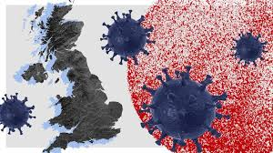
2. year 2220
You are living history at the minute Banks Lane! The year 2020 and the impact of Covid-19 will be studied all across the world in years to come by children your age. Write a letter to the children in the year 2220. Tell them all about what is happening in your world now? What is it like for you and your family? What are you enjoying? What challenges do you face?

Slide 4
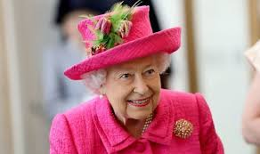
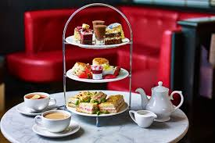
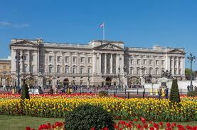
3. Tea with the queen
Pretend you have been invited to Buckingham Palace to have tea with the Queen.
Why have you been invited?
What special thing have you done?
What would you WEAR??
What would you say?
Who would you take?
Write a diary about your afternoon with the Queen - remember to include all the details!

