Slide 1
Mrs Wraith’s weekly writing challenges
Hello Banks Lane!
Each week I will set 3 new writing challenges for you to have a go at in your learning logs. Have fun and send us your amazing ideas.

Slide 2
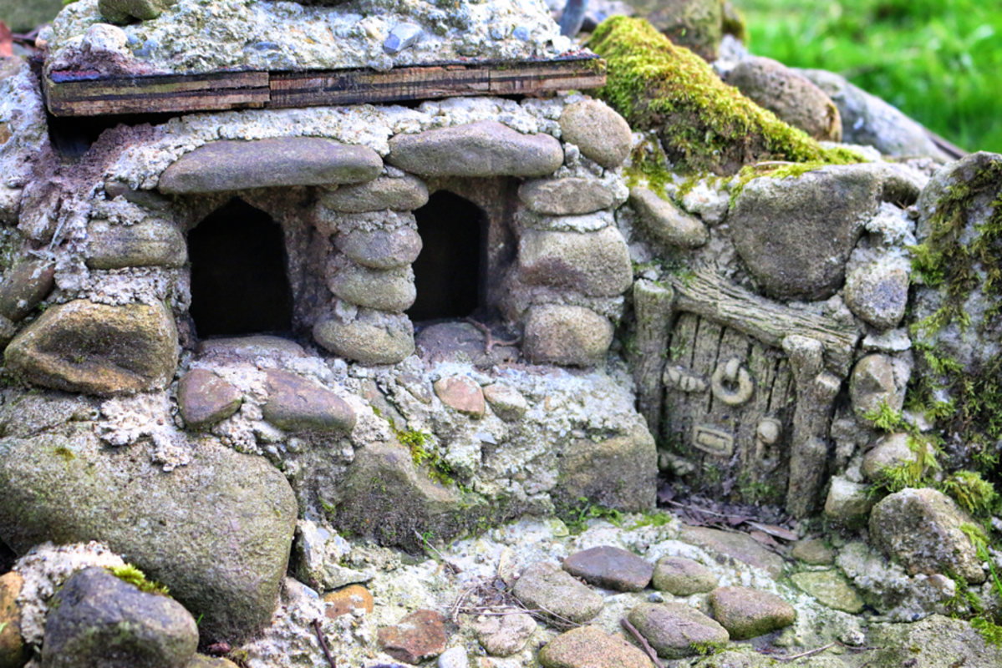
1. Who lives here?
One day you are playing in the garden and you discover a small house made from stone...
Who lives in this house?
Where is it exactly?
What is it like inside?
Write a short about your door – no more than 500 words!

Slide 3
2. Where will you go?
Draw a picture of your feet or draw around your feet in your book.
At the moment, our feet are not travelling very far! Inside your feet, write down all the places they will travel when lockdown is over. Maybe they will go to:
your grandparents house
the park
your friend’s house
school
the countryside
your favourite restaurant

Slide 4
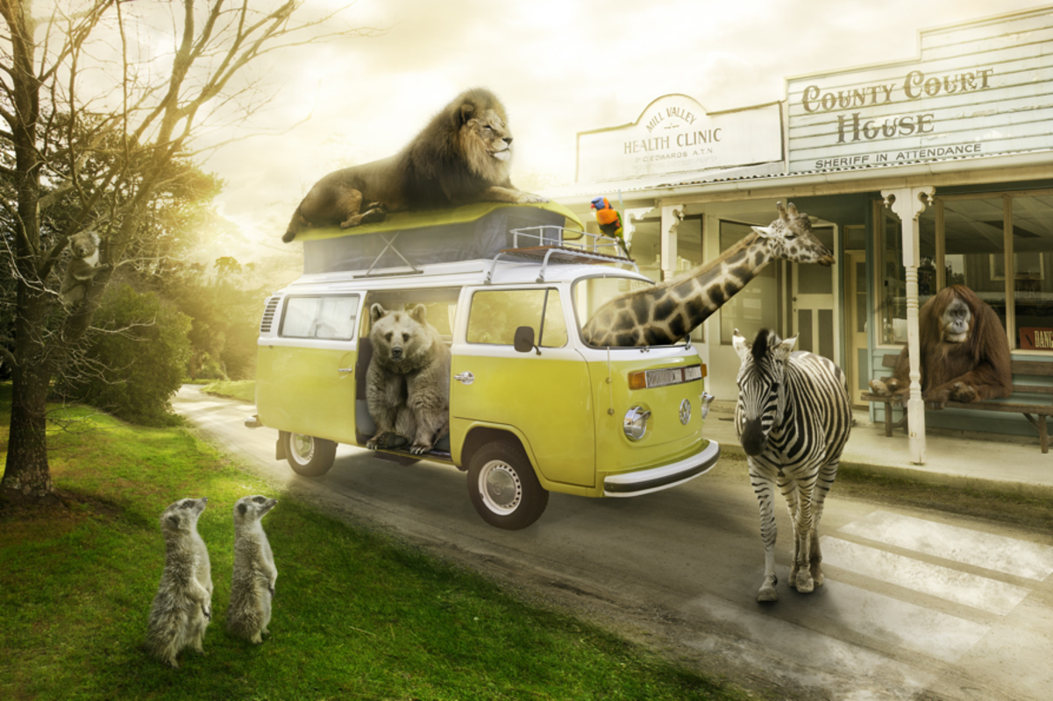
3. Zoo escape!
Have you seen these animals? They have ESCAPED from the zoo!
Pick an animal:
Lion
Bear
Giraffe
Zebra
Orangutan
Meerkat
Get into character as that animal and write a brief account of the days events as if you were them.

