Slide 1
Mrs Wraith’s weekly writing challenges
Hello Banks Lane!
Each week I will set 3 new writing challenges for you to have a go at in your learning logs. Have fun and send us your amazing ideas.

Slide 2
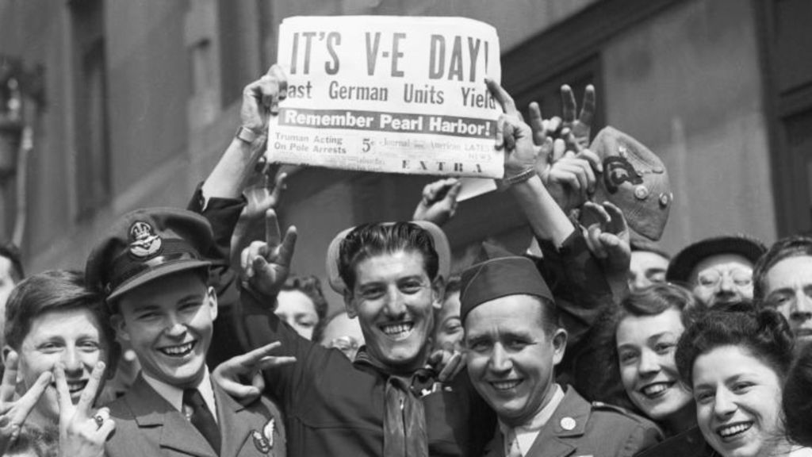
1. VE DAY party
What will you do at home to commemorate VE Day?
This week we celebrate the 75th anniversary of VE Day (Victory in Europe Day) which marks the end of World War Two. On 8th May 1945, Winston Churchill made an announcement on the radio that war in Europe had ended after Germany had surrendered. On this day we remember the WW2 generation and all those who have fought for our country.
Plan a Party!
Imagine you are planning a VE Day party – what do you need to do?
Guest list
Food and drink list
Decorations
Music
Games
Speeches
In your learning log plan your party using lots of lists (Y6 don’t forget those bullet point rules! )

Slide 3
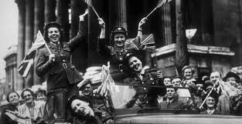
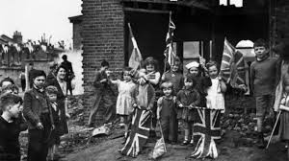
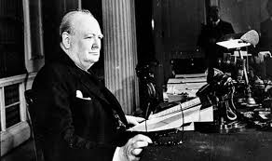
2. Ve day poetry
VE DAY POEM
Can you write your own VE day poem? Maybe you can read it out at your party you have just planned?
Follow the link to the VE Day poem – can you write one similar?
It doesn’t have to be the memories of an evacuee – you can write as a soldier in the war or a wife waiting for the return of her husband – you choose!

Slide 4
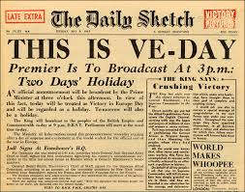
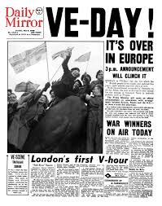
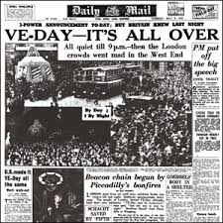
3. VE day Newspaper
Pretend you are a journalist for a local newspaper in Stockport. Can you write a short newspaper article reporting on the events of VE Day in 1945?
Date your report the day after (09/05/1945) and start with the facts in your lead paragraph – talk about Churchill's speech.
Then continue to tell your reader all about the local celebrations – don’t forget quotes from your sources!
Click on these links to help you with your report.
CBBC VE Day
The British Newspaper Archive
History for Kids
The British Legion
This task may take a couple of days!

