Slide 1
Mrs Wraith’s weekly writing challenges
Hello Banks Lane!
Each week I will set 3 new writing challenges for you to have a go at in your learning logs. Have fun and send us your amazing ideas.

Slide 2
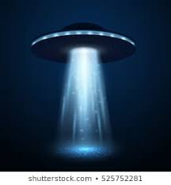
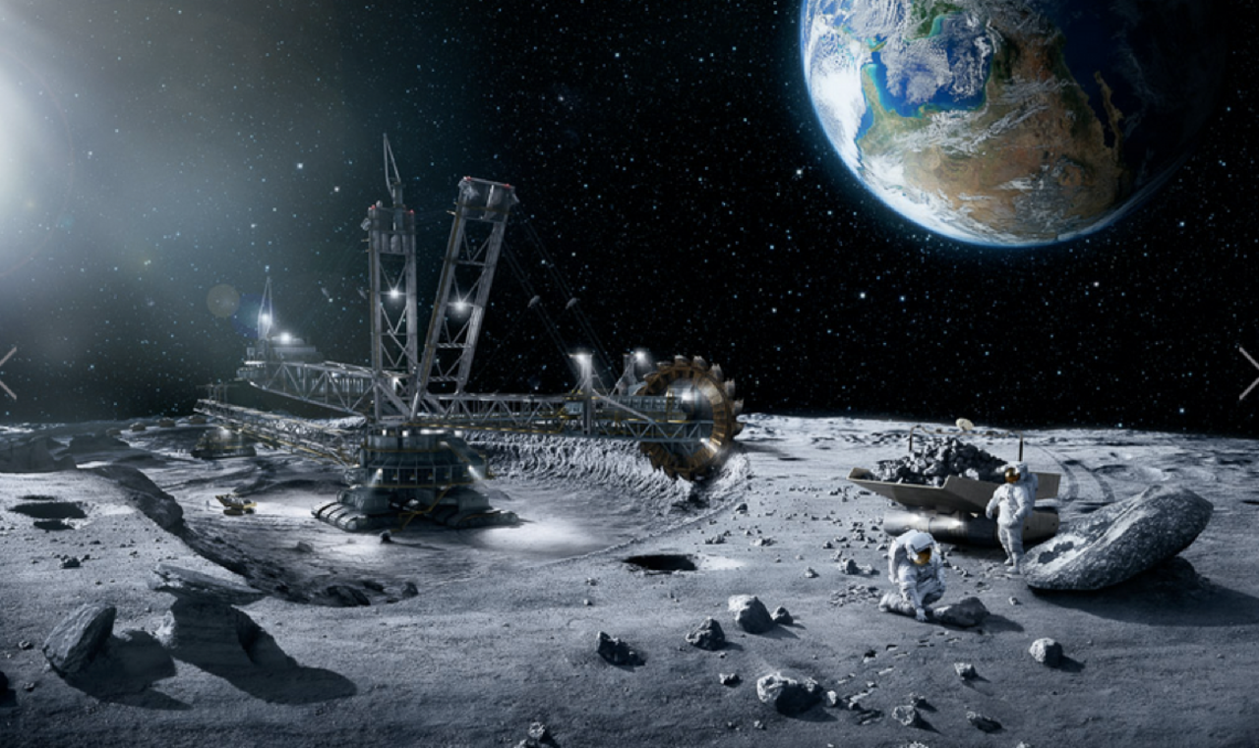
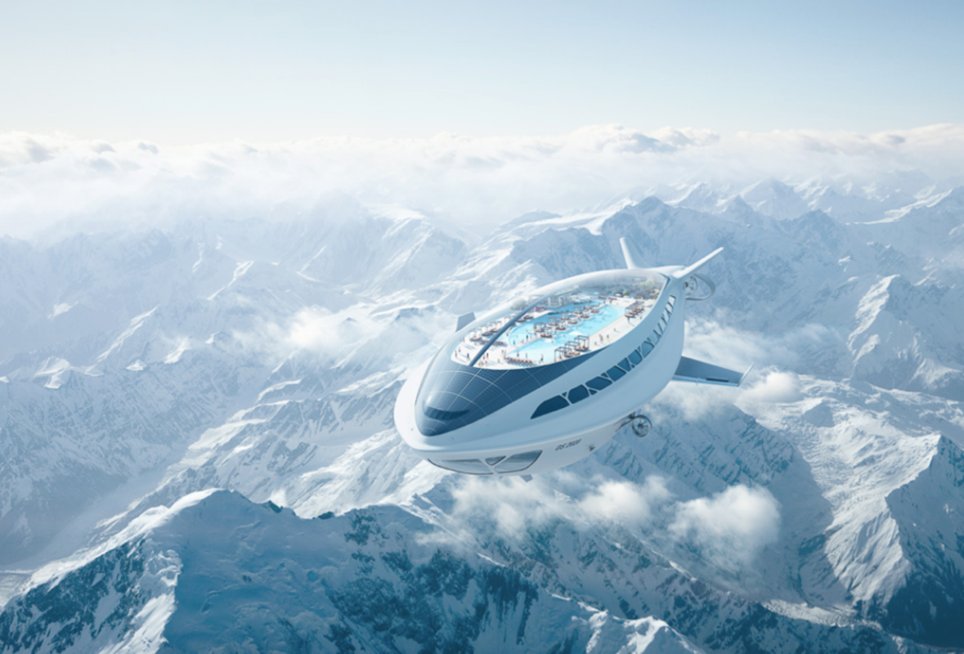
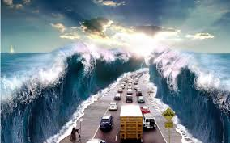
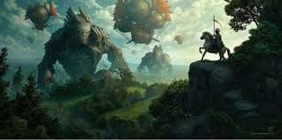
1. Another planet
Imagine that this morning you woke up on another planet, draw yourself and all the amazing things you would see.
Then write about your planet. Include amazing adjectives, powerful verbs and awesome adverbs to describe.

Slide 3
2. Riddles Can you solve Mrs Wraith’s riddle?
You may enter, but you may not come in, I have space, but no room, I have keys, but open no lock. What am I?
Exploring riddles allows you to be a detective and a spy, following clues, and writing in code. Writing a riddle is the reverse of solving a puzzle – you have to start with the answer. First, choose something to write about e.g. objects or animals.
Once you know the solution, you have to think of the clues that will lead someone to guess it. Imagine you are that thing, and describe yourself.
Can you write your own riddle?

Slide 4
3. MARVEL vs DC
What is happening in this picture?
The Marvel Superheroes DO NOT seem
impressed with Batman!
Can you write the dialogue between the characters?
Try your best to use ALL the rules for speech punctuation.

